Slide 1
03 | Introduction to relational databases
Susan Ibach | Technical Evangelist
Christopher Harrison | Content Developer

Slide 2
Module Overview
What is a relational database?
Product comparisons
Creating tables

Slide 3
What is a relational database?

Slide 4
Many computer applications have a need to store different types of data
Customers, orders, and shipping information for an online store
Product inventory at different retail stores
Details about movies such as reviews, actors, and where you can go see the movie
Information about which students are taking which courses

Slide 5
All these scenarios have relationships between the different records stored
Each customer places one or more orders
Each order is placed by a customer
Each inventory item is located in a store
Each store has product inventory
Each actor acts in one or more movies
Each movie features one or more actors
Each student takes one or more courses
Each course is taken by one or more students
customer
actor
Inventory item
student
movie
order
store
course

Slide 6
When you see relationships in the data you store,
it's time to consider a relational database!

Slide 7
When you use a relational database you store data in one or more tables
Student
StudentId | Name | Email
1 | Usha | usha@outlook.com
2 | Susan | susan@outlook.com
3 | Christopher | christopher@outlook.com
Customer
CustomerId | Name | City | Country
1 | Bill | Seattle | USA
2 | Satya | Seattle | USA
3 | Susan | Ottawa | Canada
Course
CourseId | Name | CreditHrs
100 | Intro to Python | 5
101 | Python and Flask | 4
102 | Python and databases | 4
Order
OrderId | OrderDate | CustomerId | DateShipped
1000 | 10-JAN-2000 | 1 | 1-DEC-2014
1001 | 13-MAY-2013 | 1 | 15-MAY-2013
1002 | 28-FEB-2013 | 2 | 05-MAR-2013
Grade
CourseId | StudentId | Grade
100 | 1 | A+
100 | 2 | B-
101 | 2 | A

Slide 8
Related tables have a common column that allows us to match up records
CustomerId in the Order table allows us to find matching records in the Customer table
Which orders were placed by the customer named Bill?
What's the name of the customer who placed order 1002?
Customer
CustomerId | Name | City | Country
1 | Bill | Seattle | USA
2 | Satya | Seattle | USA
3 | Susan | Ottawa | Canada
Order
OrderId | OrderDate | CustomerId | DateShipped
1000 | 10-JAN-2000 | 1 | 1-DEC-2014
1001 | 13-MAY-2013 | 1 | 15-MAY-2013
1002 | 28-FEB-2013 | 2 | 05-MAR-2013

Slide 9
Sometimes the relationships can get more complicated
Student
StudentId | Name | Email
1 | Usha | usha@outlook.com
2 | Susan | susan@outlook.com
3 | Christopher | christopher@outlook.com
The foreign key StudentId in the Grade table allows us to map grades to students
The foreign key CourseId in the Grade table allows us to map grades to courses
How do we know which students took which courses?
We have to look at the Grade table
Course
CourseId | Name | CreditHrs
100 | Intro to Python | 5
101 | Python and Flask | 4
102 | Python and databases | 4
Grade
CourseId | StudentId | Grade
100 | 1 | A+
100 | 2 | B-
101 | 2 | A

Slide 10
Can you figure out
Student
StudentId | Name | Email
1 | Usha | usha@outlook.com
2 | Susan | susan@outlook.com
3 | Christopher | christopher@outlook.com
What grade Susan received for the Python and Flask course?
The names of the students who took the Intro to Python course?
Course
CourseId | Name | CreditHrs
100 | Intro to Python | 5
101 | Python and Flask | 4
102 | Python and databases | 4
Grade
CourseId | StudentId | Grade
100 | 1 | A+
100 | 2 | B-
101 | 2 | A

Slide 11
Product Comparisons

Slide 12
There are many relational database products on the market including:
SQL Server
Oracle
MySQL
Access
Microsoft Azure SQL Database

Slide 13
SQL Server and Oracle are full featured relational databases
You can get SQL Server Express or Oracle Database Express for free
The paid versions offer increased functionality
SQL Server runs on Windows
Oracle runs on Windows or Linux

Slide 14
MySQL
MySQL is an open source relational database product
You can get MySQL Community Server for free
The paid versions offers increased functionality
MySQL runs on Windows and Linux (or in the cloud)

Slide 15
Access
Access is a relational database tool which includes the ability to build own forms and reports
Access is part of Office Professional or Office 365
Access 2013 actually uses SQL Server or Microsoft Azure SQL Database to store it's data
Access runs on Windows

Slide 16
Microsoft Azure SQL Database
Microsoft Azure SQL Database is a database stored in the cloud
You don't need to install the software on a server or worry about product updates
You pay a monthly fee then create your tables and store your data in the cloud (pricing calculator)
The data stored in the cloud can be accessed by anyone with permission to access your database and an internet connection

Slide 17
How do I set up my database?

Slide 18
Here are the steps
Install your selected database product
Create the database
Create your tables

Slide 19
The next version of our application needs the following tables
Questions
QuestionName | Description | CorrectAnswer | CategoryId
HockeyFact | How long is one period of hockey | 20 minutes | 1
FranceCapital | What is the capital of France? | Paris | 2
CanadaCapital | What is the capital of Canada? | Ottawa | 2
Categories
CategoryId | Description
1 | Sports
2 | Geography
3 | Science

Slide 20
MySQL

Slide 21
MySQL – 1. Installing the product
Run the MySQL Installer http://dev.mysql.com/downloads/installer/
Select the developer default installation and use the default configuration options
Specify and make a note of the password for the Root Account

Slide 22
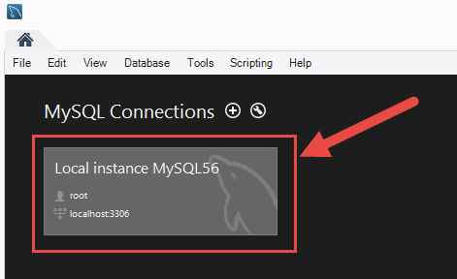
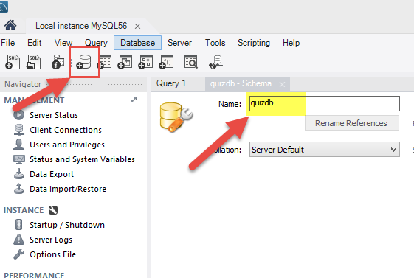
MySQL – 2. Create the database
Launch MySQL Workbench
Select the local instance connection
Select Create a new schema and give it a name

Slide 23
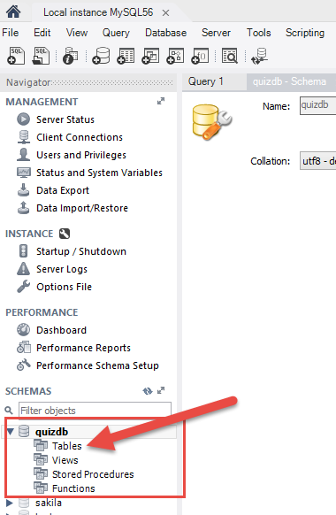
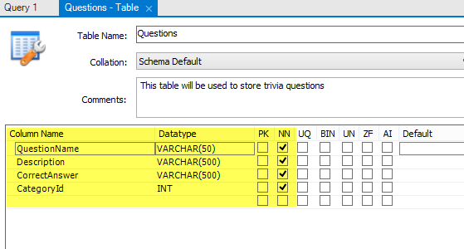
MySQL – 3. Create your tables
Double click on your schema in the Navigator
Expand the schema, right click Tables and select Create Table
Enter a Table Name, and a Column Name and Data Type for each column
Deselect NN if that column is allowed to be blank

Slide 24
You can also use SQL to create your table
Questions
QuestionName | Description | CorrectAnswer | CategoryId
HockeyFact | How long is one period of hockey? | 20 minutes | 1
FranceCapital | What is the capital of France? | Paris | 2
CanadaCapital | What is the capital of Canada? | Ottawa | 2
CREATE TABLE TableName (
ColumnName1 datatype(size) NULL | NOT NULL,
ColumnName2 datatype(size) NULL | NOT NULL,
… )
CREATE TABLE Questions (
QuestionName VARCHAR(50) NOT NULL,
Description VARCHAR(500) NOT NULL,
CorrectAnswer VARCHAR(500) NOT NULL,
CategoryId INT NOT NULL)

Slide 25
SQL Server

Slide 26
SQL Server – 1. Installing the product
Install Microsoft SQL Server Express with Tools
There are lots of resources to help you with installation and questions about the product on the Express Resources site

Slide 27
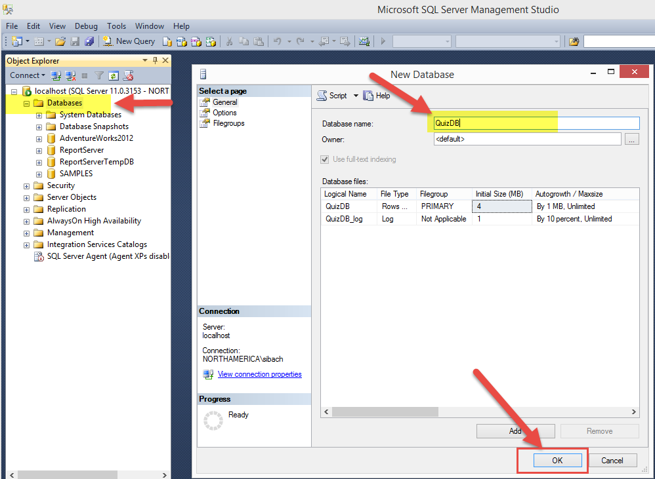
SQL Server – 2. Create the database
Open SQL Server Management Studio
Right Click Databases and select New Database
Type in a database name and select OK

Slide 28
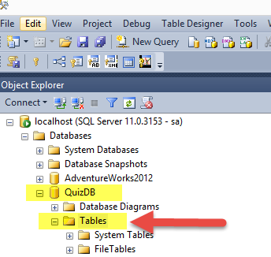
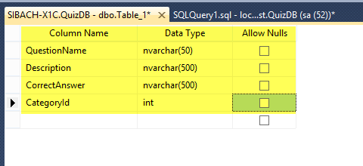
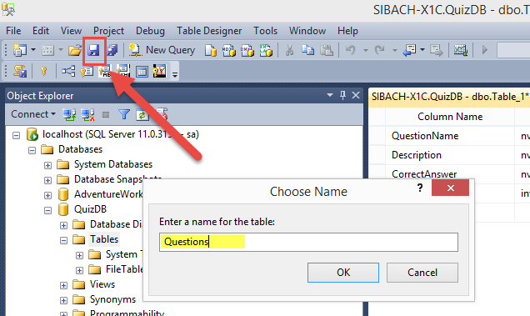
SQL Server – 3. Create your tables
Expand your database in the Object Explorer
Right click Tables and select New Table
Enter a Column Name and Data Type for each column
Select Allow Nulls if that column is allowed to be blank
Save and name your table

Slide 29
You can also use SQL to create your table
Questions
CREATE TABLE questions
(QuestionName NVARCHAR(50) NOT NULL,
Description NVARCHAR(500) NOT NULL,
CorrectAnswer NVARCHAR(500) NOT NULL,
CategoryId INT NOT NULL)
QuestionName | Description | CorrectAnswer | CategoryId
HockeyFact | How long is one period of hockey? | 20 minutes | 1
FranceCapital | What is the capital of France? | Paris | 2
CanadaCapital | What is the capital of Canada? | Ottawa | 2

Slide 30
Create tables in SQL Server

Slide 31
Microsoft SQL Server in Azure

Slide 32
Azure – 1. Installing the product
When working with Microsoft SQL Server in Azure, you don't need to install any software
You do need a Microsoft Azure account
You log in to Microsoft Azure and create a Microsoft SQL Server database in the cloud

Slide 33
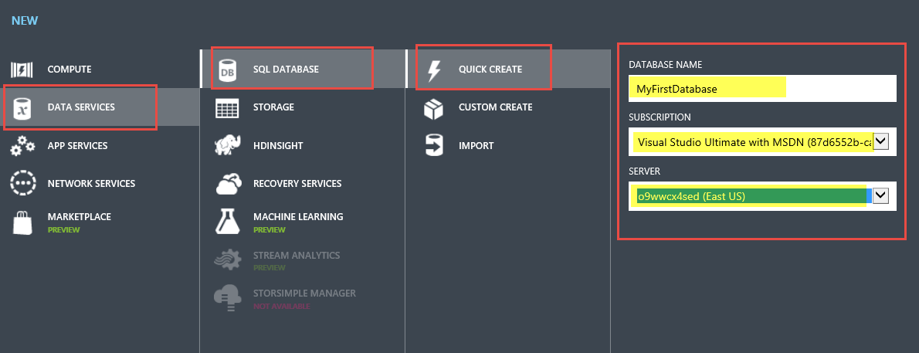
Azure– 2. Create the database
Go to the Azure portal
manage.windowsazure.com
Select +NEW | SQL DATABASE | QUICK CREATE to create a new database

Slide 34
Azure – Create your tables
To create tables in Azure we use SQL Server Management Studio (the same tool we used to create tables in SQL Server)
We need to
Tell Azure to allow our IP address to connect to the database
Find out the server name and user name to connect to the database from SQL Server Management Studio
Set the password for our database server in Azure
Connect using SQL Server Management Studio
Type a SQL Command to create the table

Slide 35
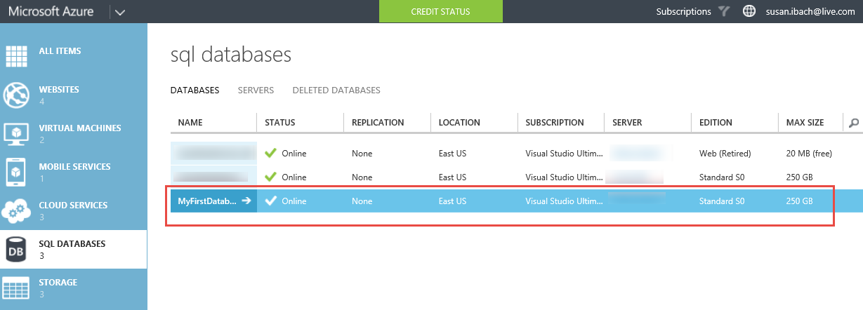
Select your database in the Azure portal

Slide 36
i) Add your IP Address to the firewall rules
Select Manage from the toolbar
Add your IP address to the existing firewall rules

Slide 37
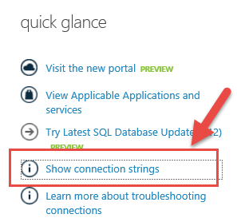
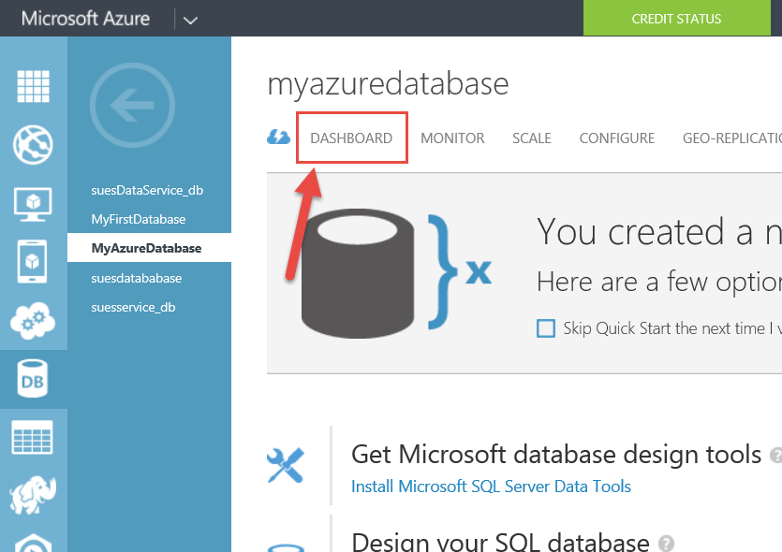
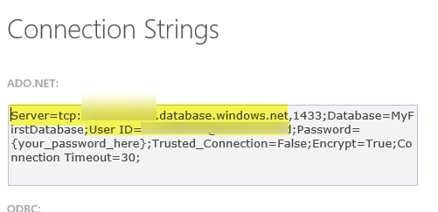
ii) Get the server name and user name
Bring up DASHBOARD for your database
Under the quick glance menu select Show connection strings
Note the server name and user name in the Connection string

Slide 38
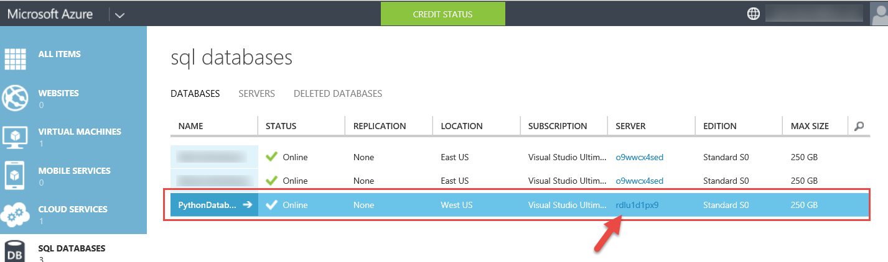
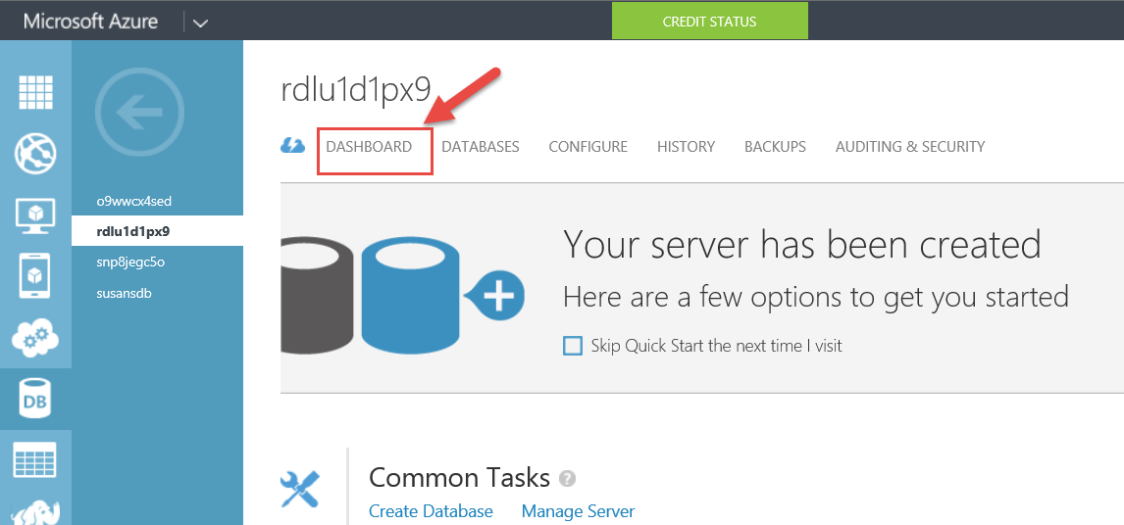
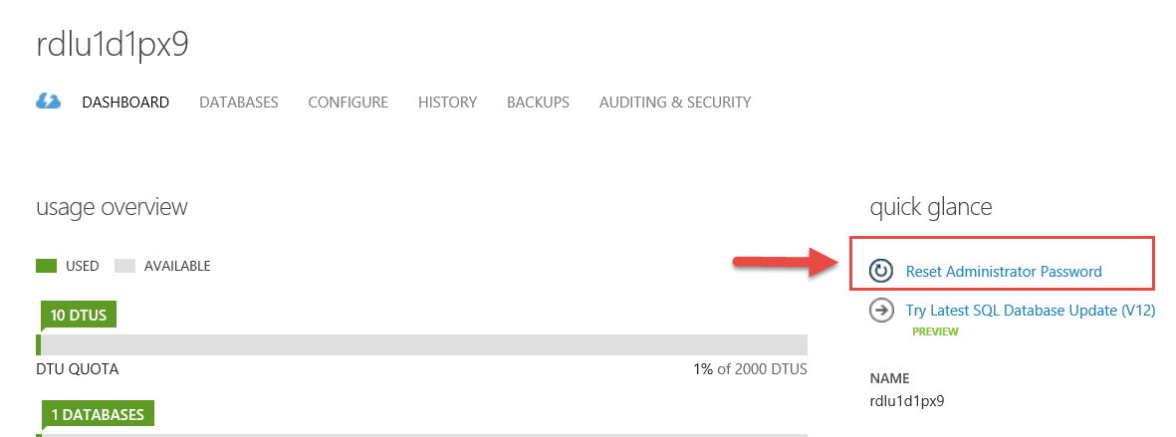
iii) Set the password for our database server in Azure
Click on the server name for your database in the Azure portal
Bring up the DASHBOARD for the server
Select reset administrator password and enter a password for the database server

Slide 39
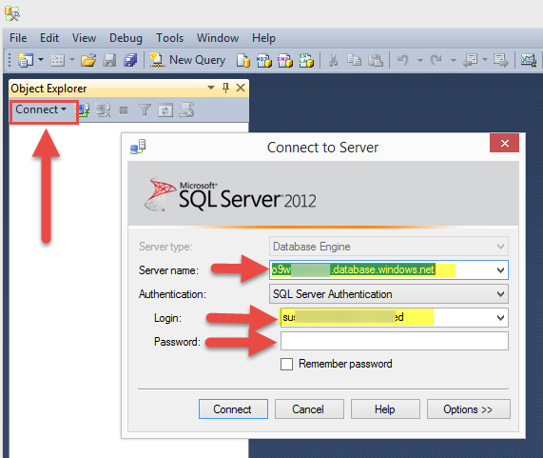
iv) Connect using SQL Server Management Studio
Enter your server name (without the "tcp:" prefix)
Select SQL Server Authentication
Enter your user ID and password

Slide 40
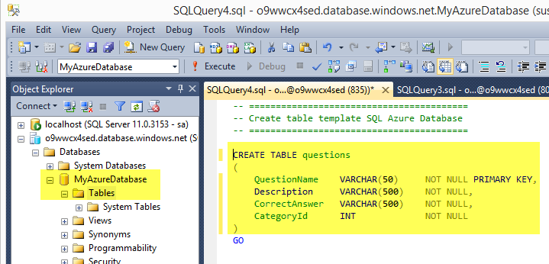
v) Type SQL Command to create your table
In SQL Server Management studio, expand your database, right click Tables and select New Table
Type the SQL Command to create your table
NOTE: SQL Azure requires a PRIMARY KEY for each table

Slide 41
Create tables in Microsoft Azure SQL Database

Slide 42
Hopefully you noticed
The syntax and tools vary slightly but the basic method for setting up a database and tables in your database is very similar no matter which product you use.
To learn more about SQL Server
To learn more about MySQL
To learn more about Microsoft Azure SQL Database

Slide 43
What did we learn?
What products you can choose from for relational databases
How to create a database and table in
SQL Server
Microsoft Azure SQL Database

